Slide 1

Smart CITY
The Wise CONN (www.thewiseconn.com)

Slide 2
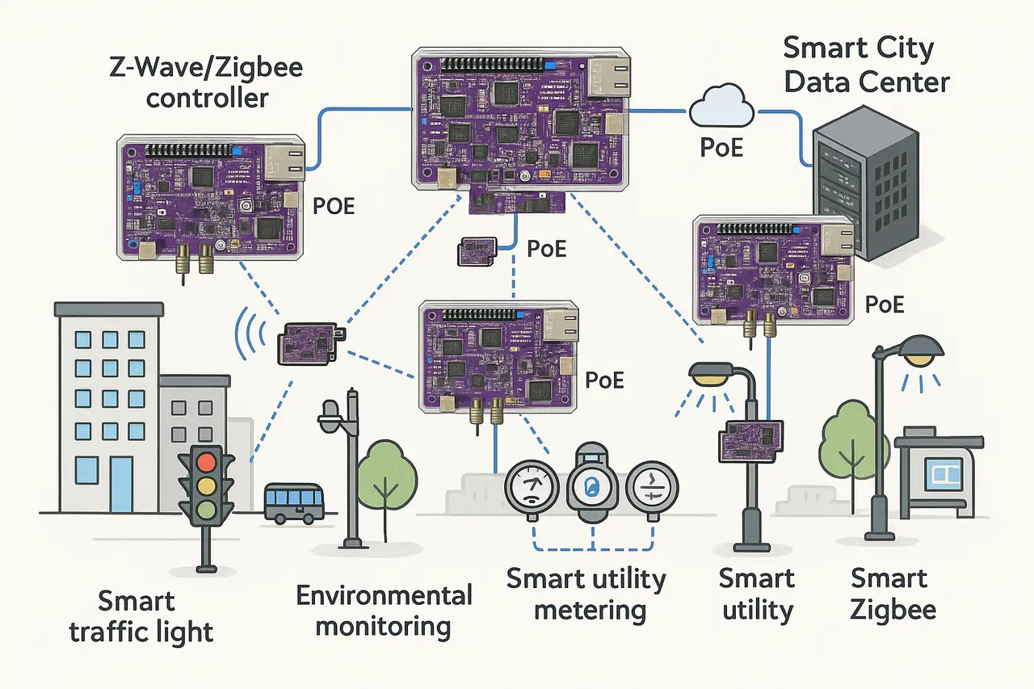
OverView

Slide 3
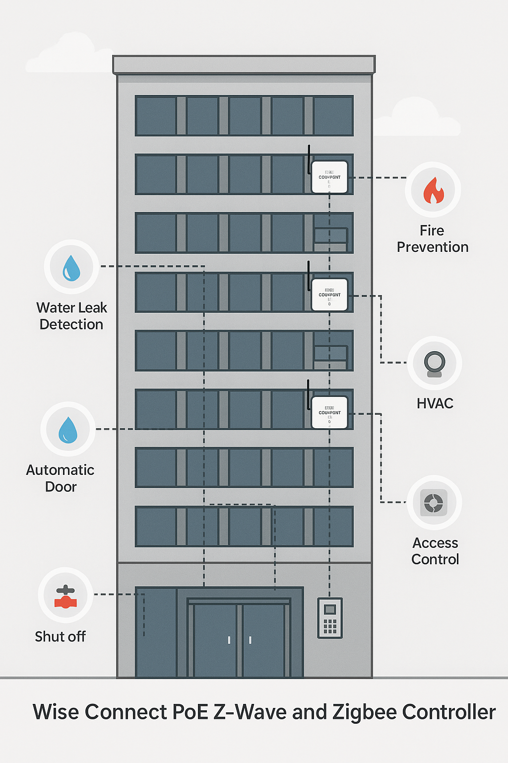
Building Intelligence

Slide 4
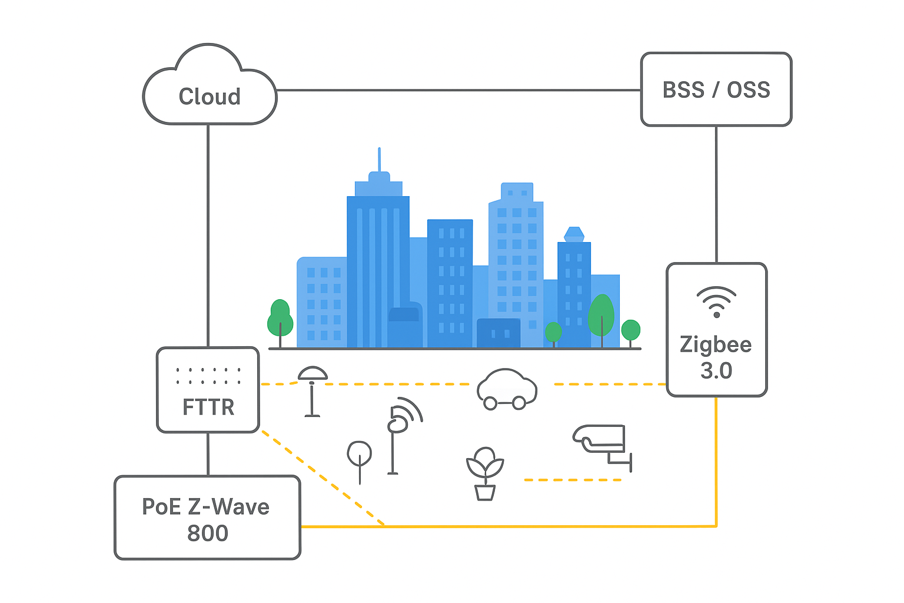
Smart City Architecture with PoE Z-Wave 800 & ZigBee 3.0

Slide 5
Market trends
The global smart city market size was valued at approximately $877.6 billion in 2024and is projected to reach
over $3.7 trillion by 2030. The global smart building market was valued at around $127.02 billion in 2024 and is expected to grow to approximately $548.5 billion by 2032.
“Fiber‑to‑the‑Room (FTTR)” global market is US$4–5.5 billion, and expected to grow with a CAGR of ~3.5 % to 22 %

Slide 6
Research and Development
We research and develop on the high tech including operational smart city and smart home, FTTR, AI Data center (large-scale Optical Circuit Switching (OCS) system, Optical on chip)
System controlled medical devices
Edge Cloud, Edge Computing (Edge AI)

Slide 7
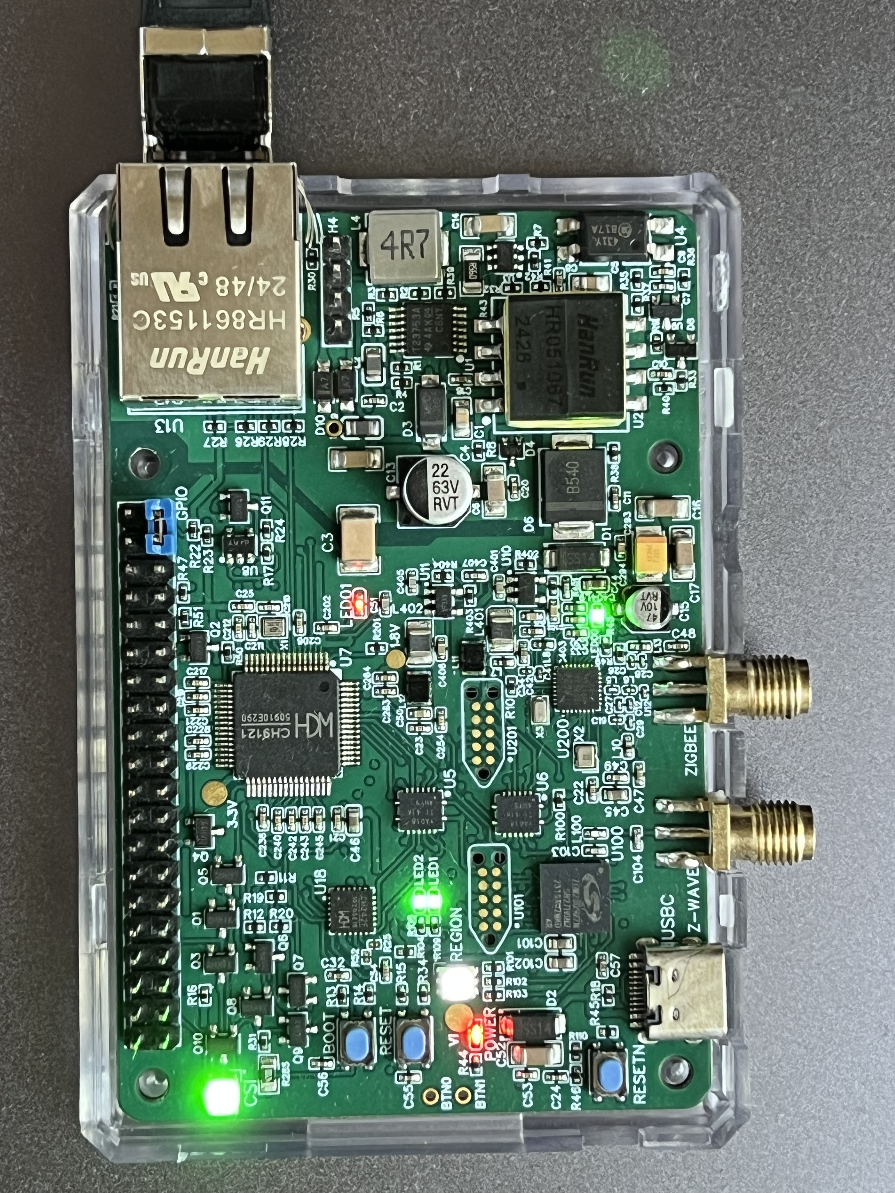
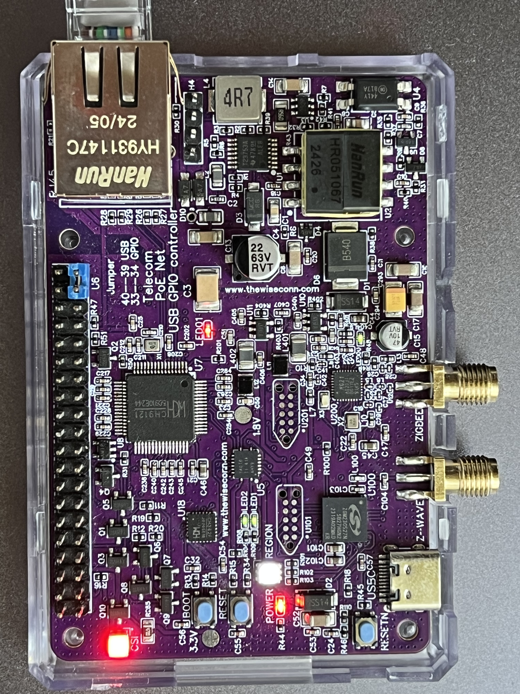
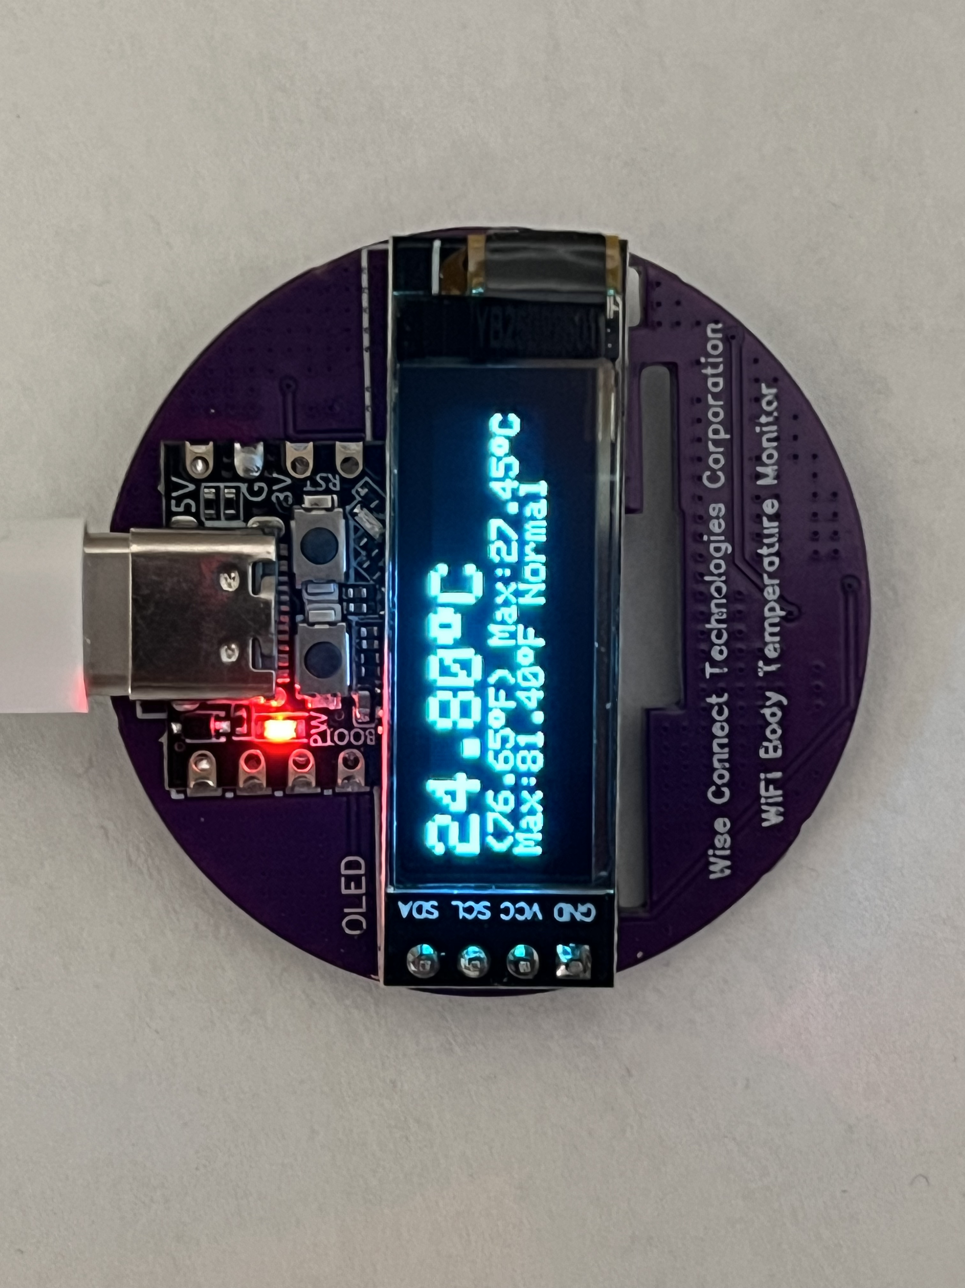
Our Products -- PoE Smart City Controller, Medical Temp Monitor

Slide 8
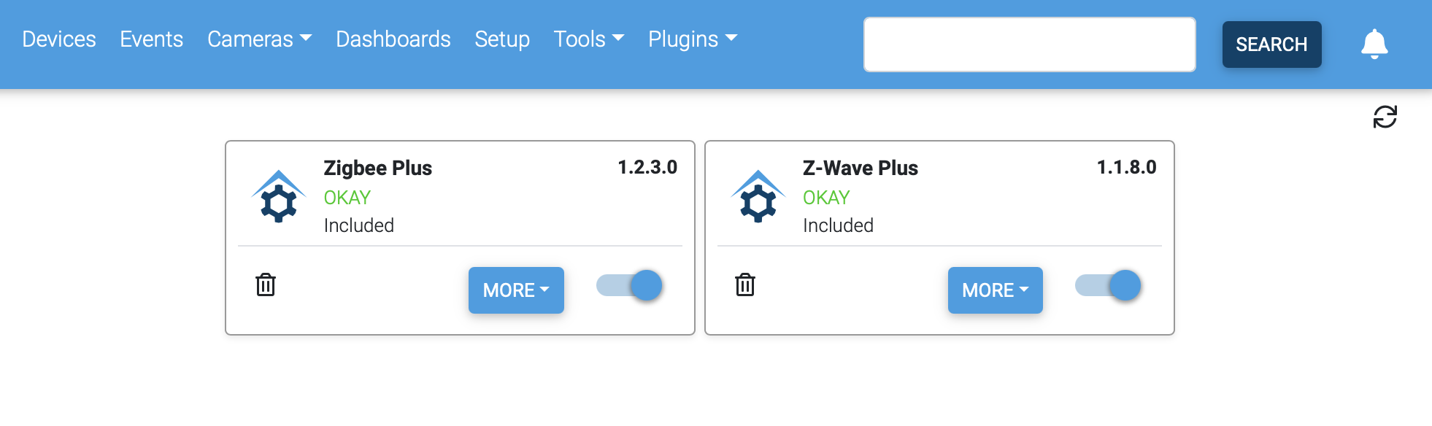
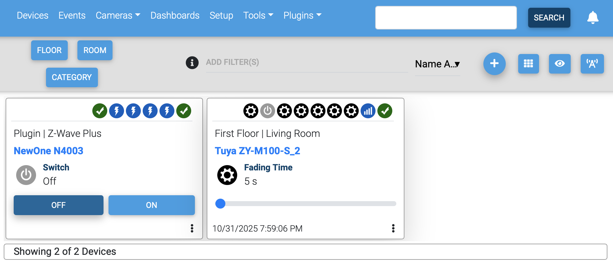

Slide 9
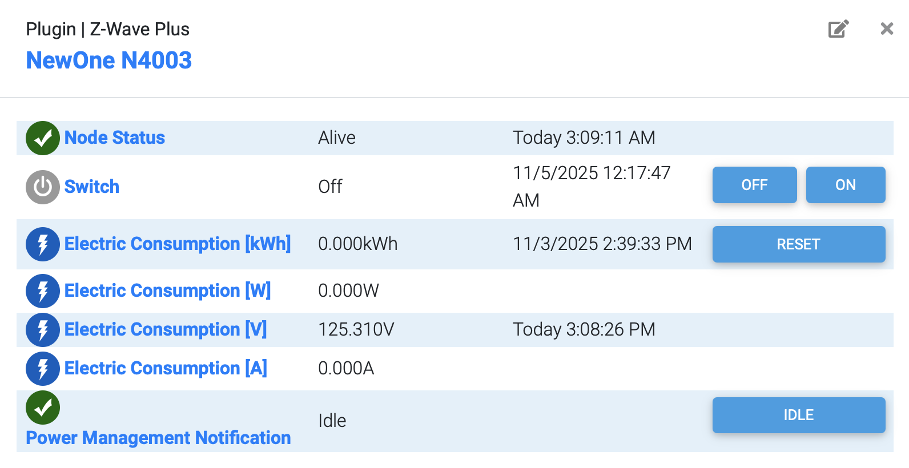
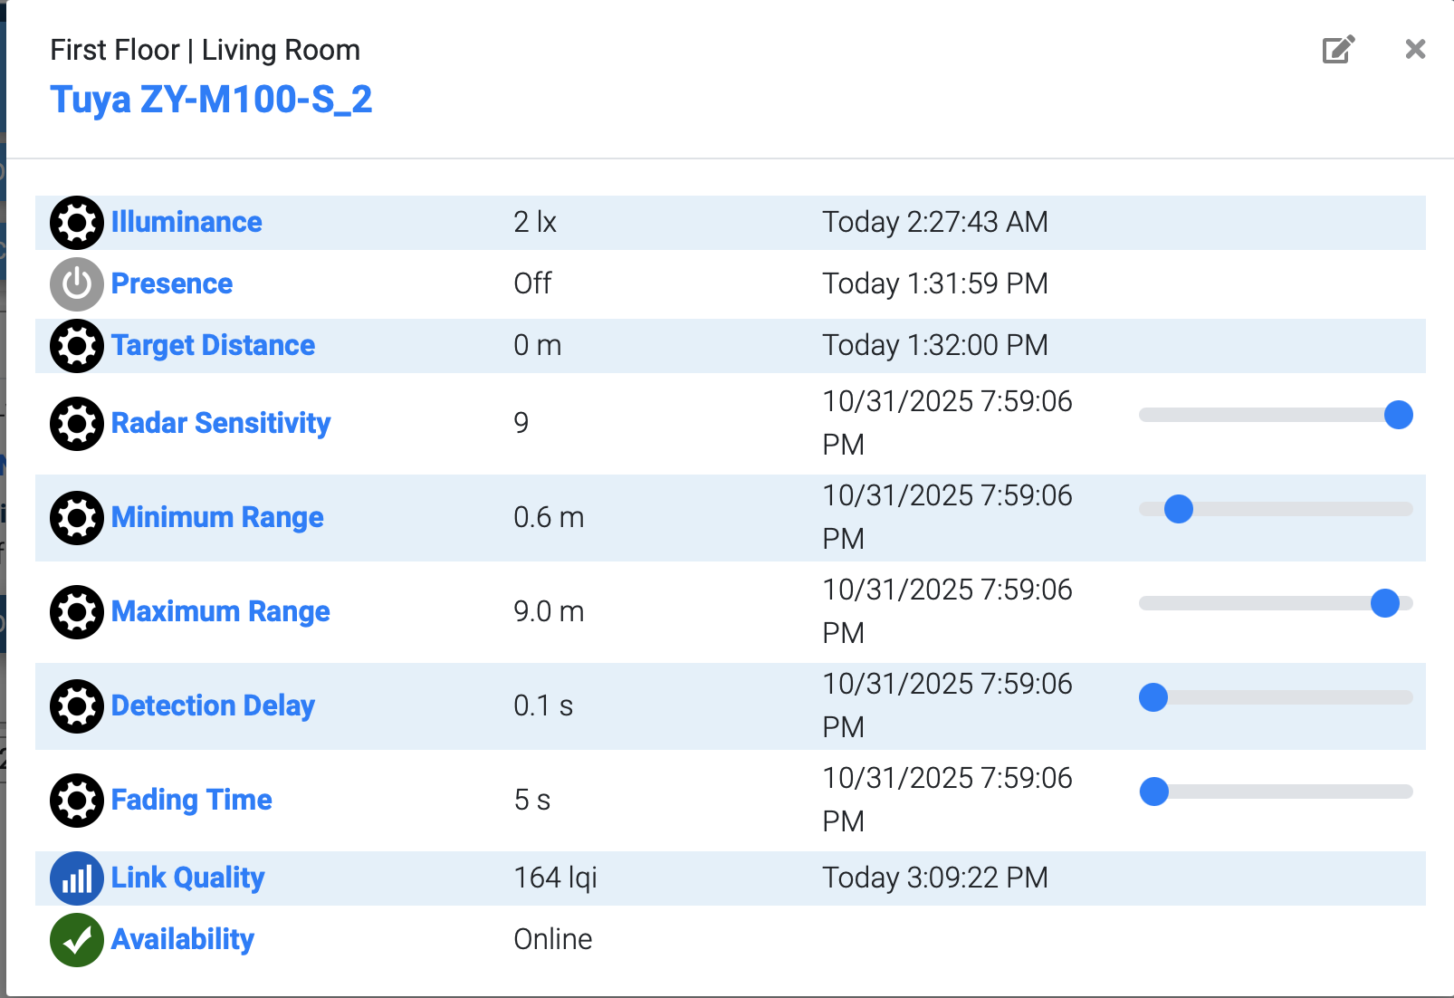

Slide 10
Core Investment Areas
Infrastructure
FTTR (Fiber to the Room) / FTTH networks for ultra-fast connectivity.
Energy-efficient smart grids and lighting.
Smart roads, parking, and traffic management systems.
IoT & Connectivity
Z-Wave, Zigbee, NB-IoT, 5G for device interconnectivity.
Sensors for environment, waste, water, and energy monitoring.
Digital Platforms
BSS/OSS for telecom operations, Edge AI
City dashboards for traffic, energy, and emergency services.
Edge cloud computing for low-latency data processing.
Mobility & Transportation
Autonomous vehicles, smart public transport.
Electric vehicle charging networks.
Dynamic traffic control and route optimization.
Security & Safety
Surveillance systems with AI analytics.
Disaster management systems.
Cybersecurity for city networks.

Slide 11
Q&A
What questions do you have?

