Slide 1

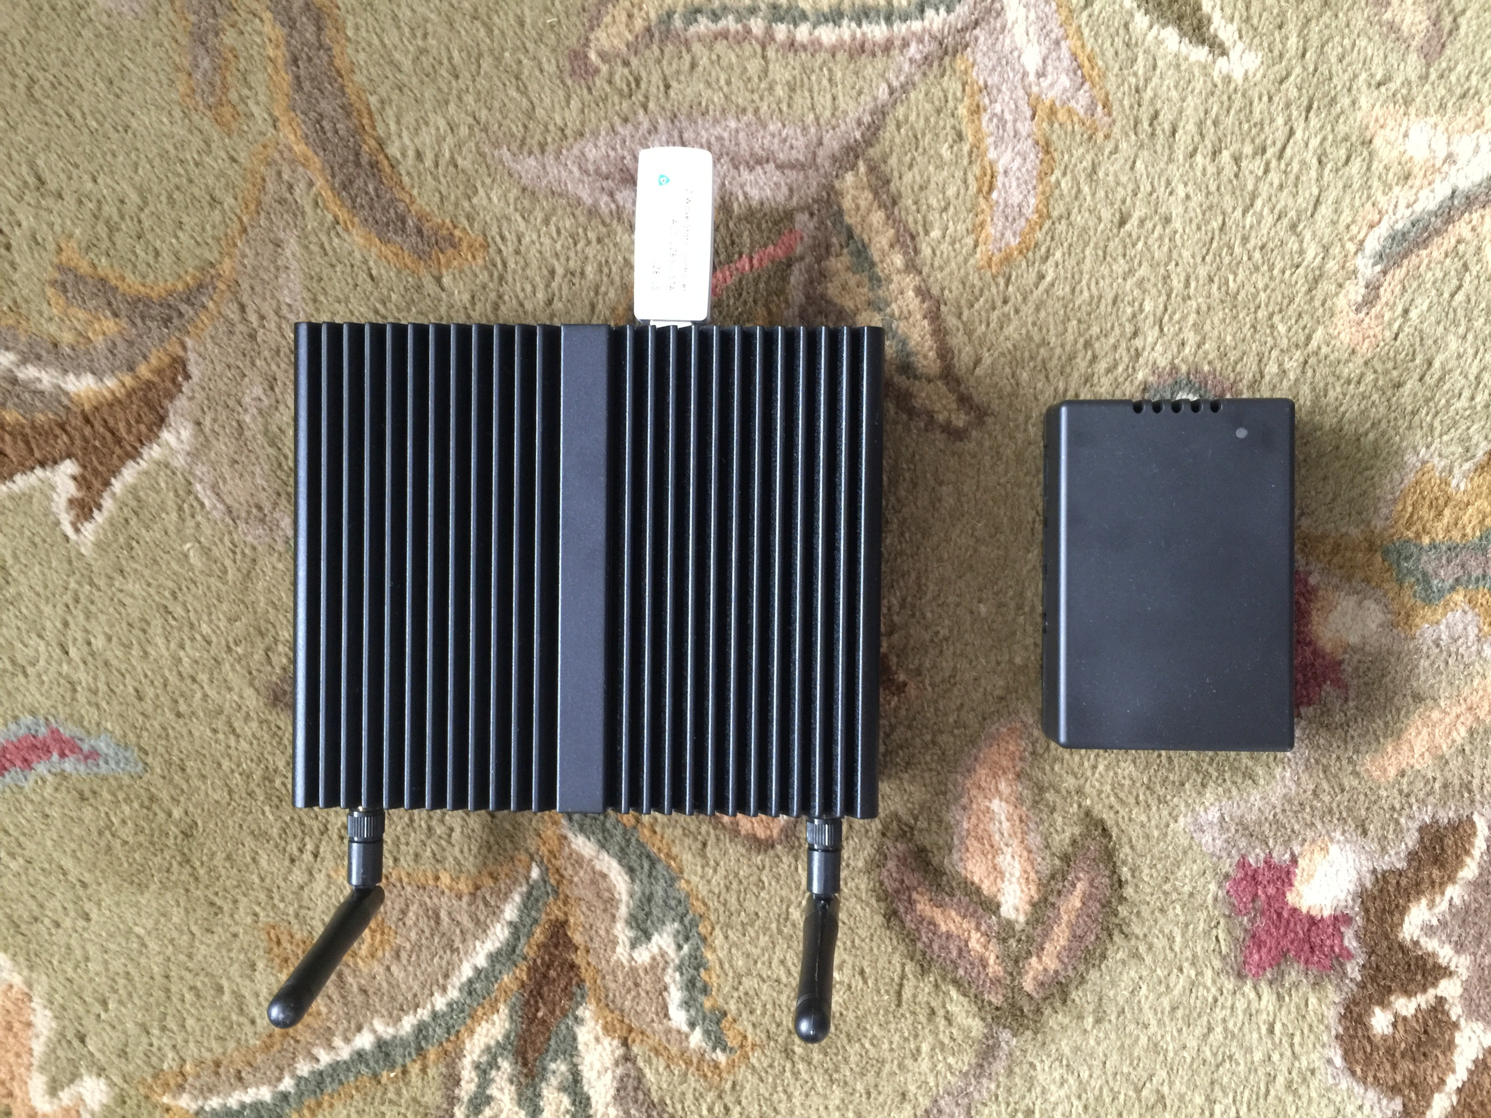
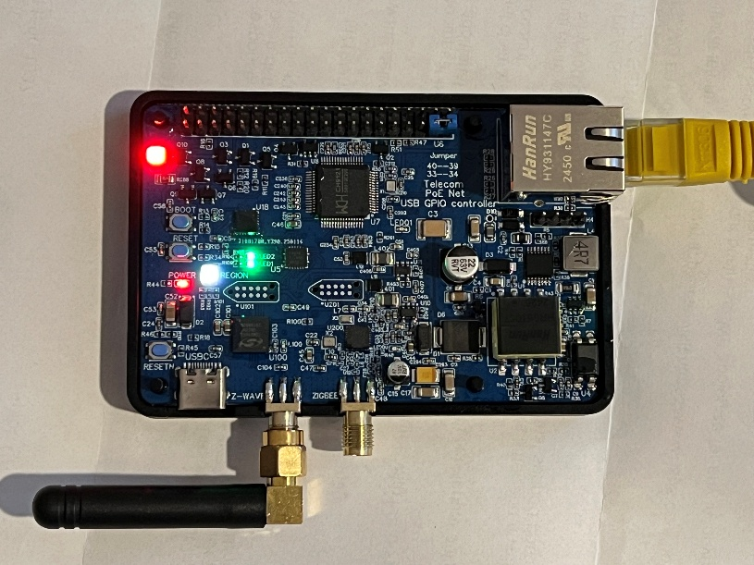
SMART HOME (thewiseconn.com)
Company Profile (www.thewiseconn.com)
Wise Connect Technologies Corporation was established in 2012 and is a company specializing in the research and development of intelligent control technology. Its products include distributed large-scale intelligent systems capable of centralized control over an entire building, community, or even an entire city.

Slide 2
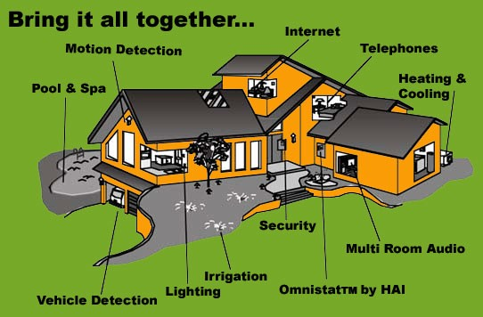
Introduction
A smart home system is an electronic system capable of intelligently controlling buildings and venues such as homes, office buildings, hospitals, and schools. An ideal smart home system should be able to understand and predict human needs and intentions and execute operations on relevant devices. Currently, the smart home system from Wise Connect Technologies Corporation can achieve partial intelligent control. Although there is still a considerable gap from the ideal system, it remains the most advanced system in the world.
Smart home systems have a history of over thirty years, evolving from the earliest X10 and UPB to Insteon, ZigBee, and Z-Wave. Smart home systems have also progressed from initial infrared remote control and power line carrier technologies to modern wireless communication and Ad-Hoc sensor network technologies. However, these networking technologies alone are insufficient. The reliability and security of the entire system, as well as the intelligence technology—which is the most critical aspect of a smart system—are the top priorities. This means the system should not require human intervention, automatically respond, and notify the owner of the results. Our system has made some beneficial explorations in intelligence, human-machine interaction, and media bandwidth adaptation.
Hardware System
The hardware system consists of a control server, interface technology devices, and other components that form the control system. Our control server can be flexibly configured, ranging from low-cost, low-power Raspberry Pi units to large-scale servers in data centers, depending on the scale of the smart home system. This is a control server capable of managing hundreds of home devices. The control server can also function as a wireless router through its settings.

Slide 3
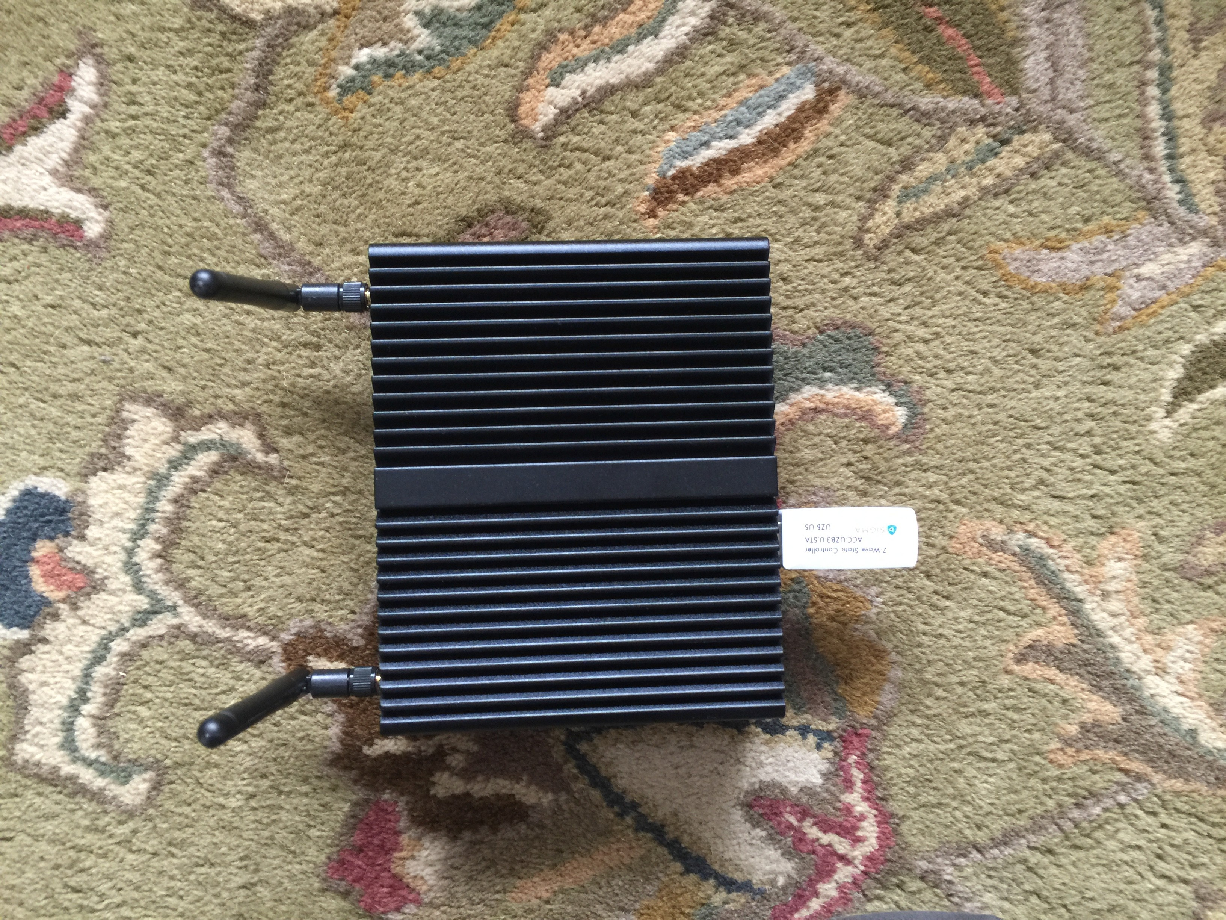
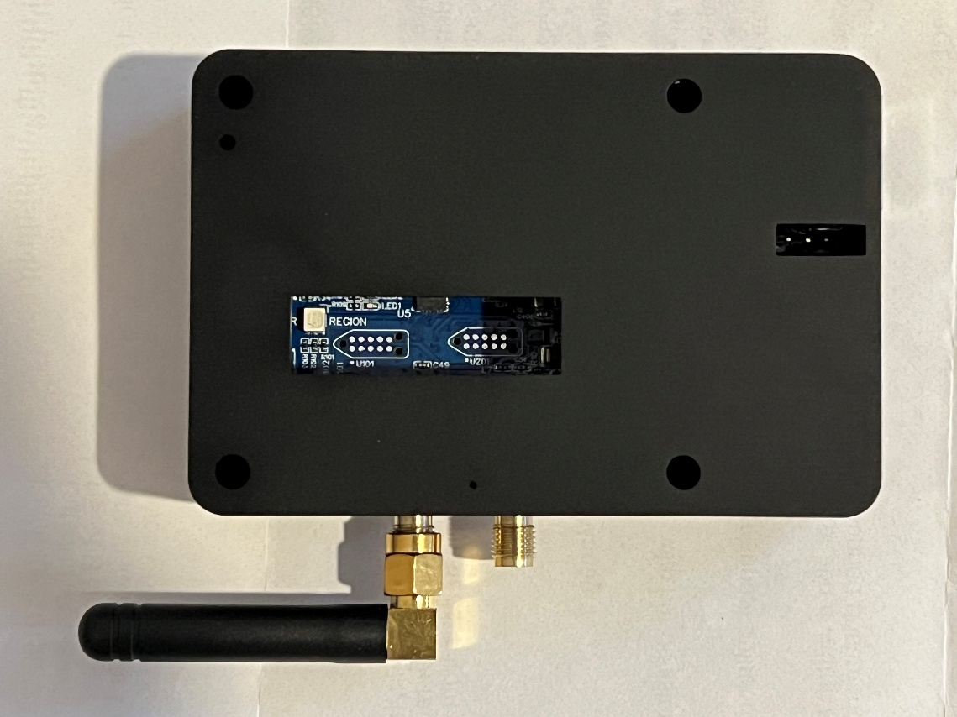
We also have the world's unique network interface technology device, which supports Z-Wave Plus, ZigBee, and other technologies, and enables mixed interactive control across various technologies. It can support remote interactive control from thousands of miles away. This is a Z-Wave Plus network interface device.

Slide 4
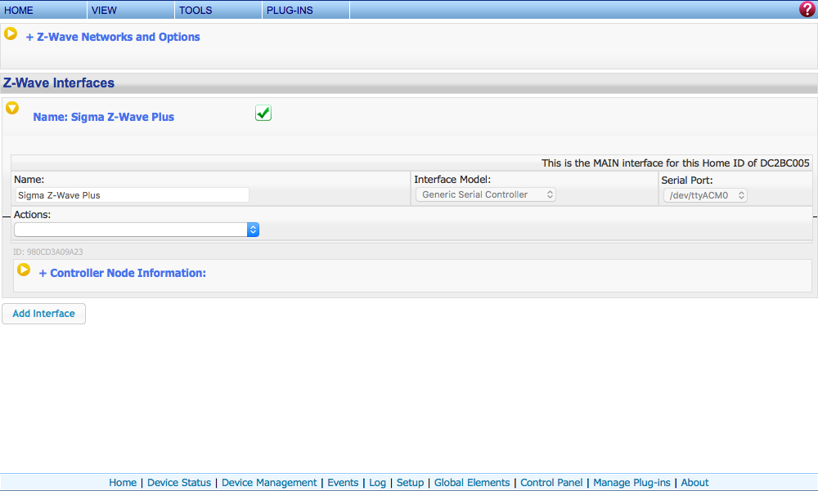
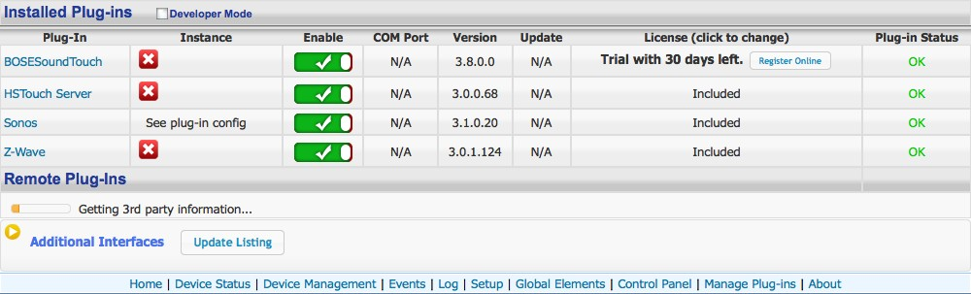
For example, you can use a ZigBee sensor to trigger and control a Z-Wave device, or use a sensor in Beijing to trigger and control a device or a series of events in New York.

Slide 5
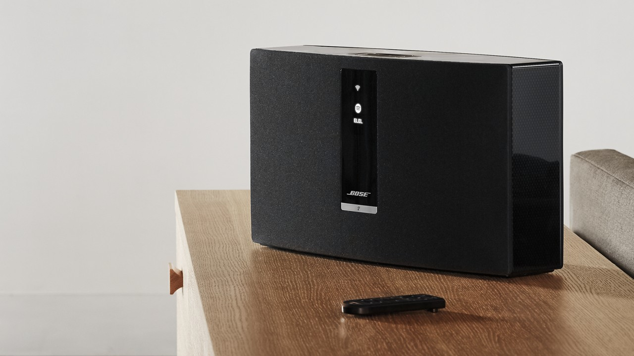
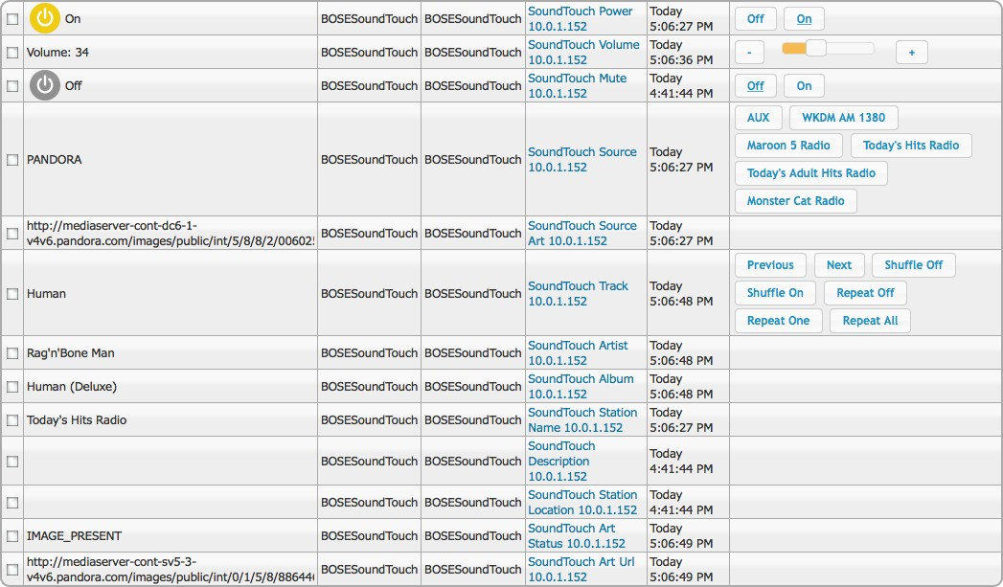
Sensors, Control Devices, and Audio-Visual Equipment Currently, the market offers a wide variety of devices, including ZigBee, Z-Wave, Insteon, X10, and UPB, with Z-Wave devices being the most abundant. Let’s first talk about audio. Our system conveniently controls devices such as Bose SoundTouch and Sonos. Bose SoundTouch
User Interfaces：

Slide 6
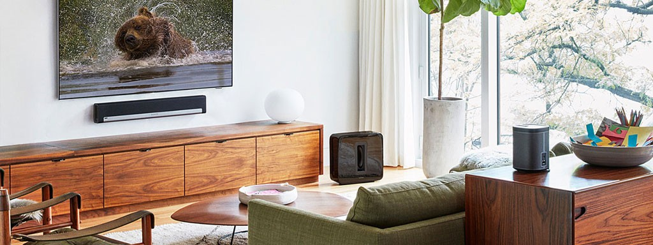
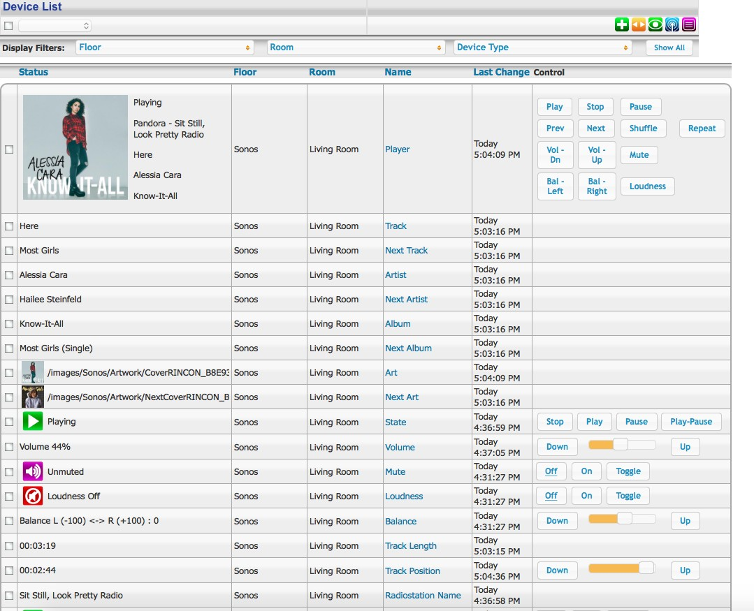
User Interface：

Slide 7
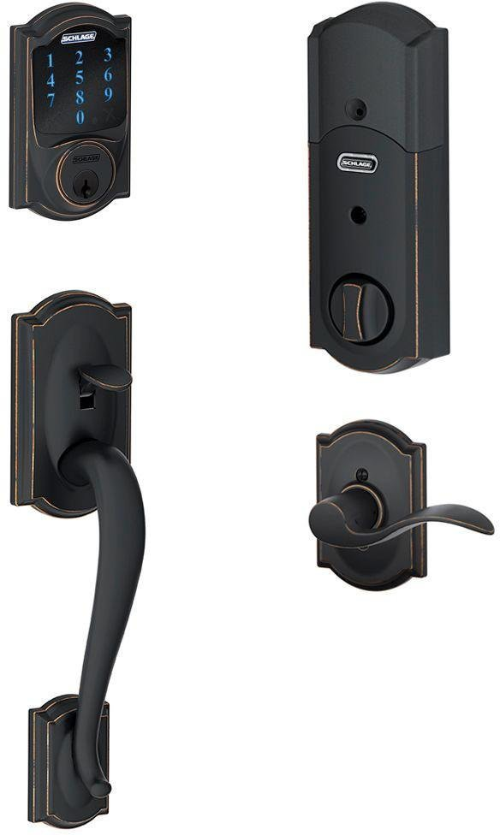
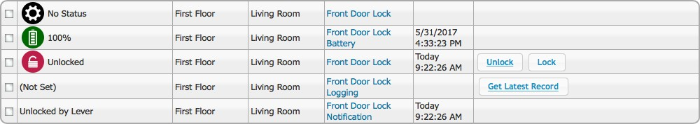
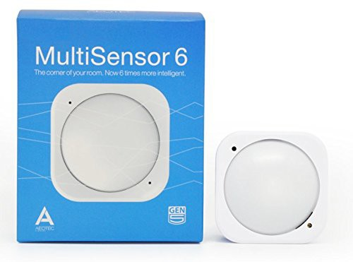
Door Locks：
Sensors:

Slide 8
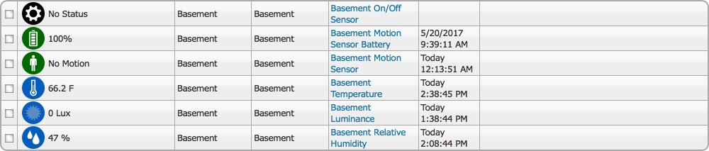
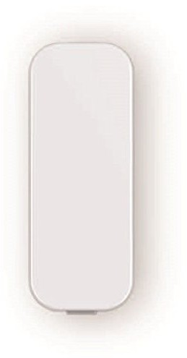
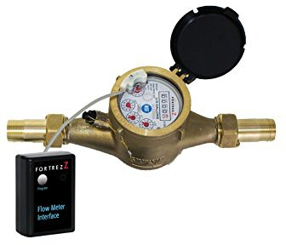
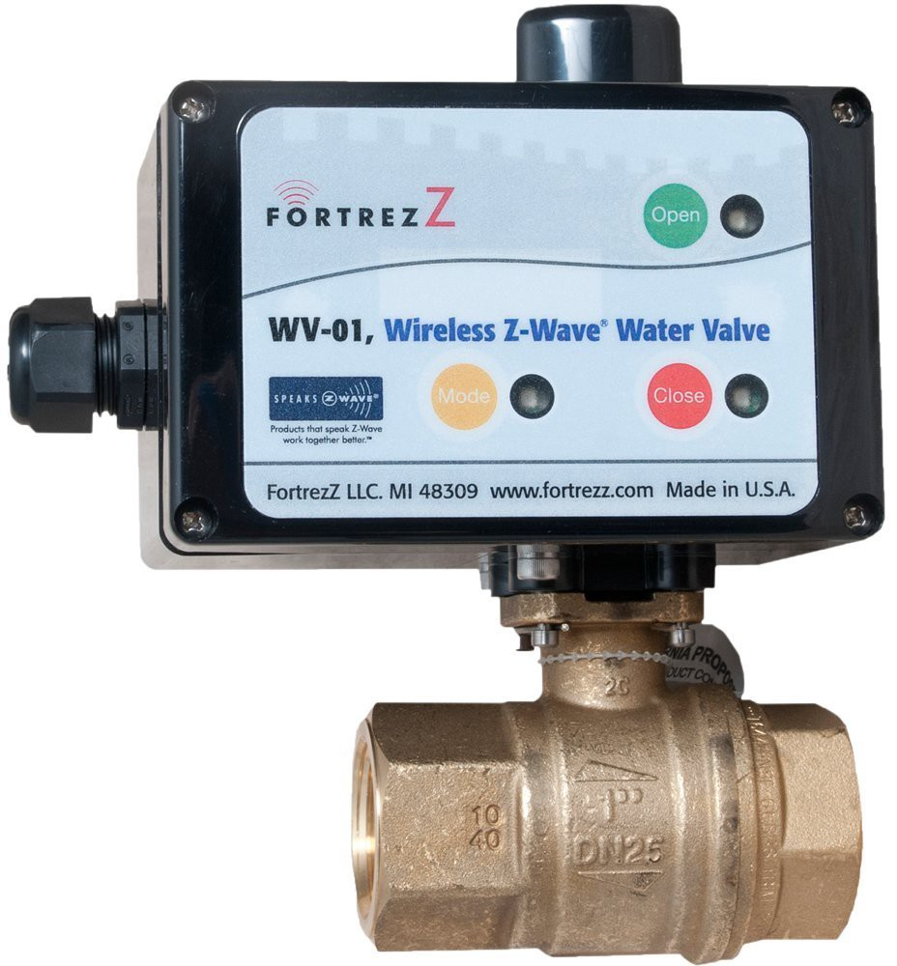
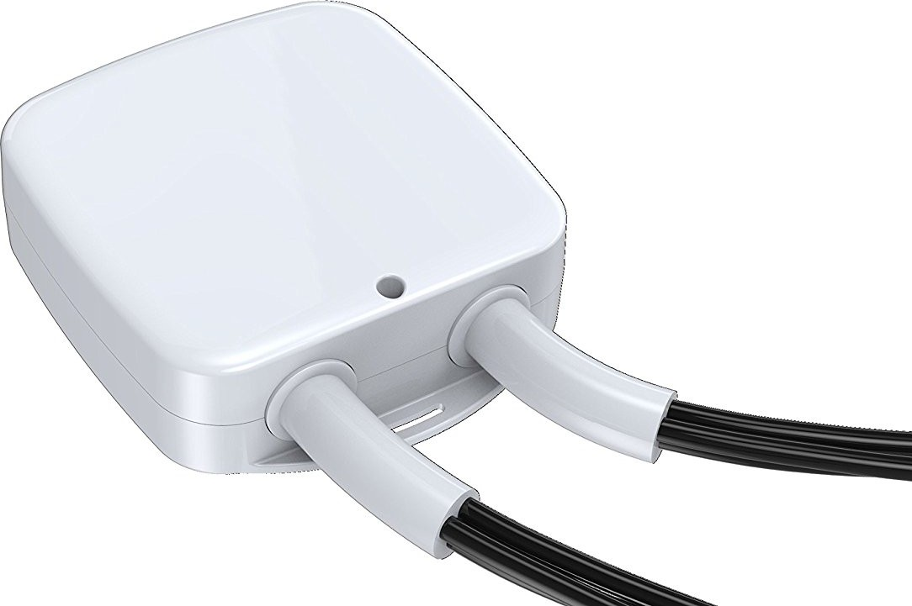
User Interface：
Combustible Gas and Water Leak Sensors, as well as Valve Control, Water Meters, and Gas Meters:
Power Switch
：

Slide 9
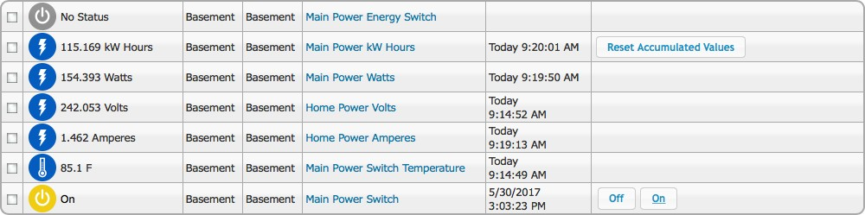
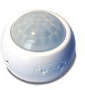
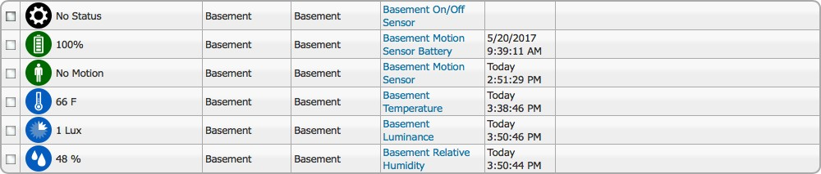
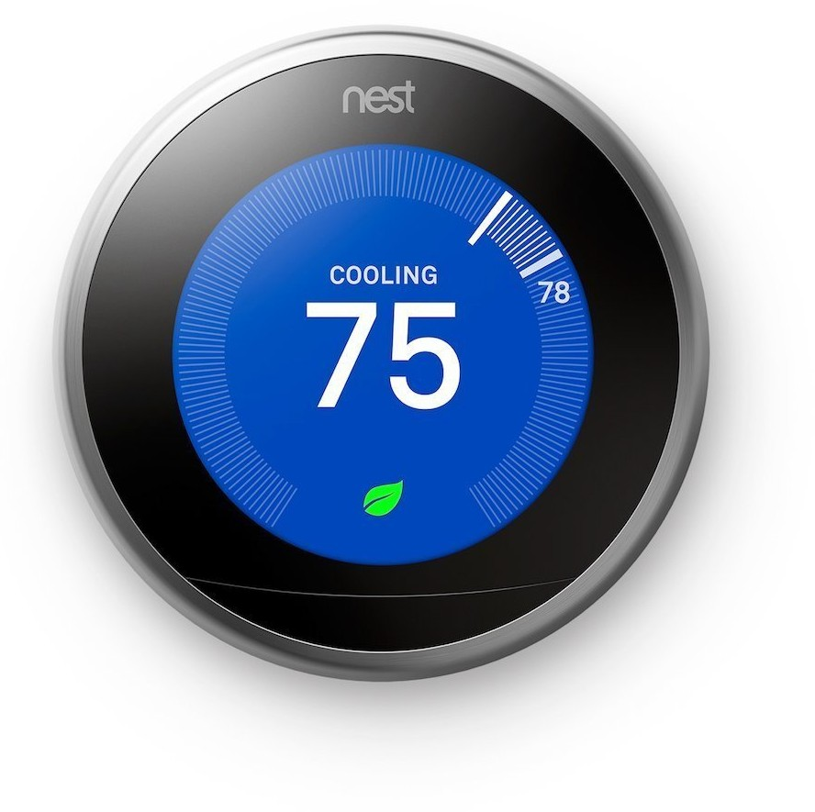
Indoor Sensor:
Central Air Conditioning and Heating Controller

Slide 10
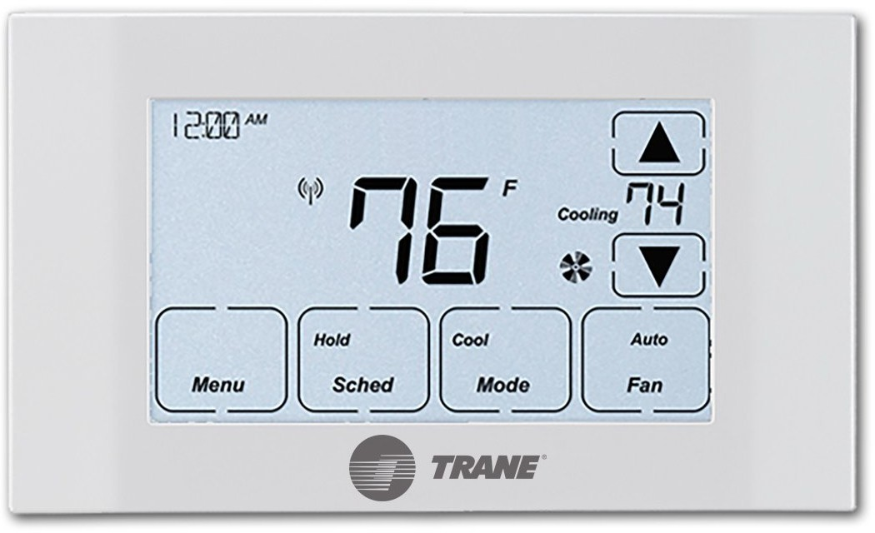
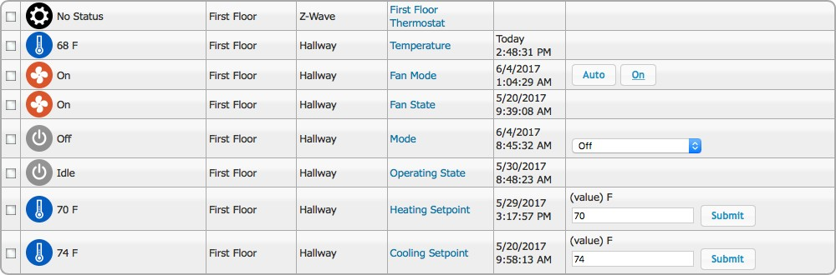
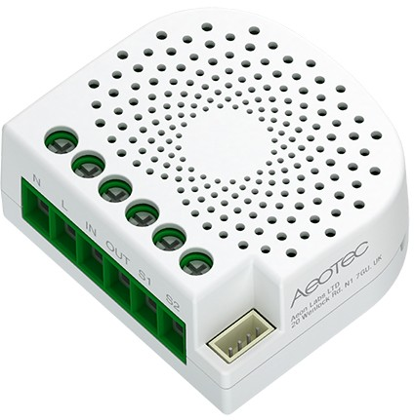
Power Switch::

Slide 11
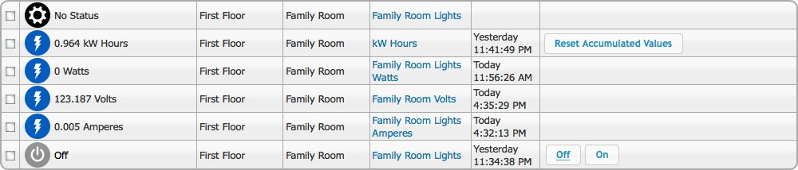
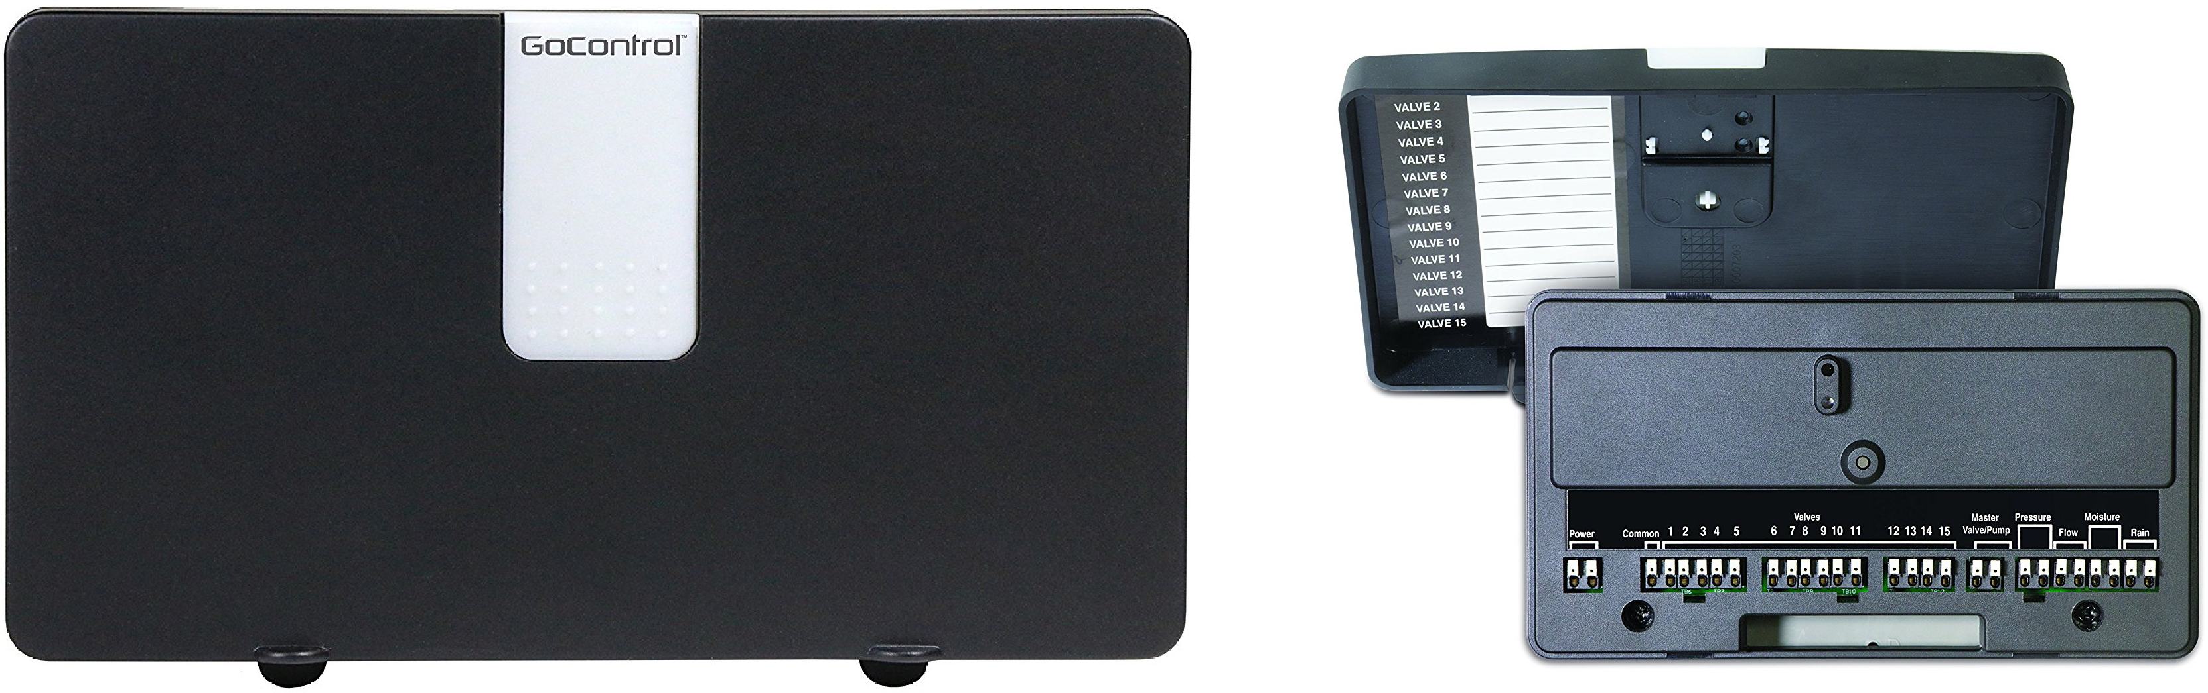
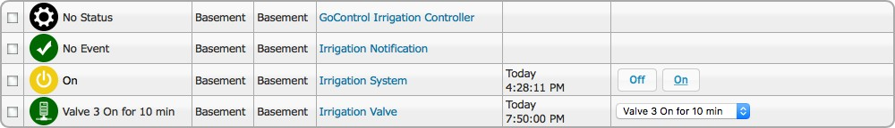
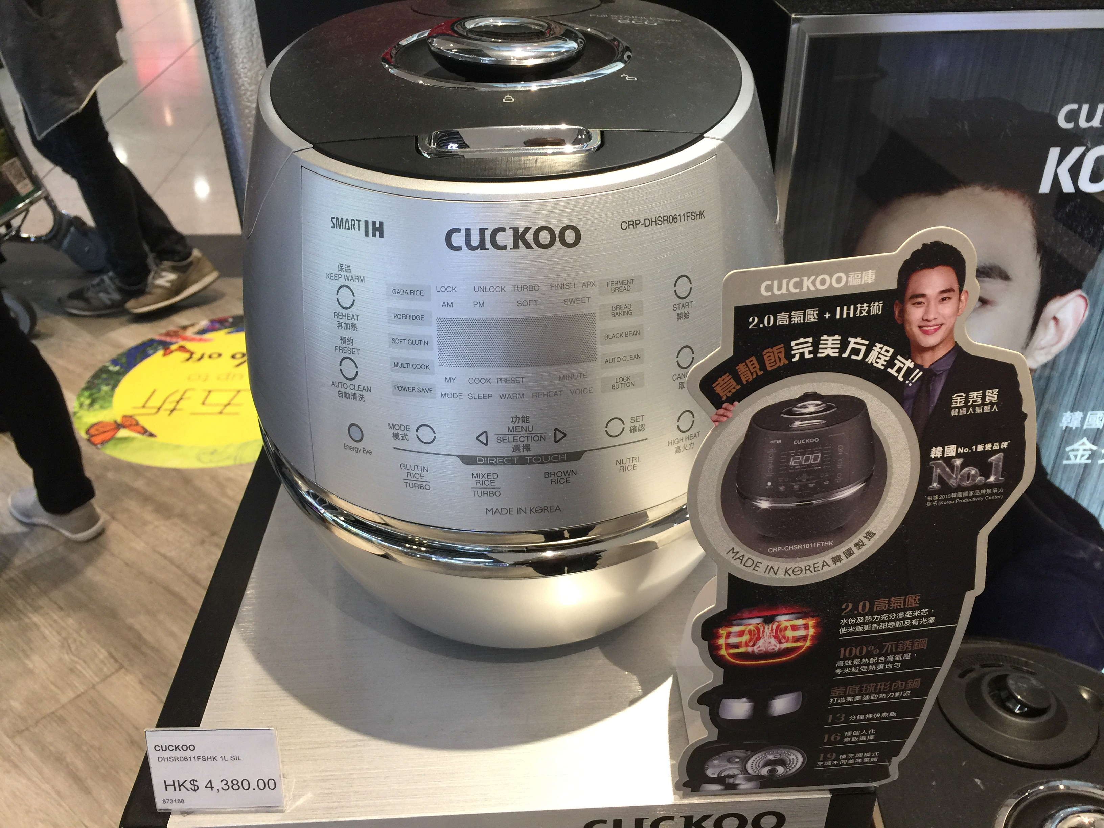
Lawn Irrigation System
Rice Cooker:

Slide 12
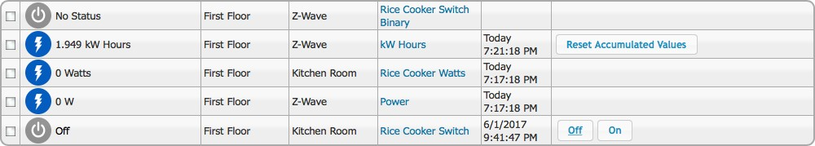
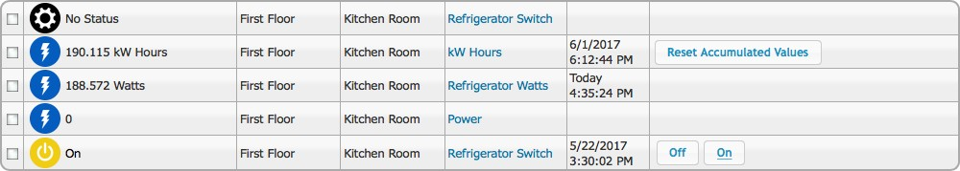
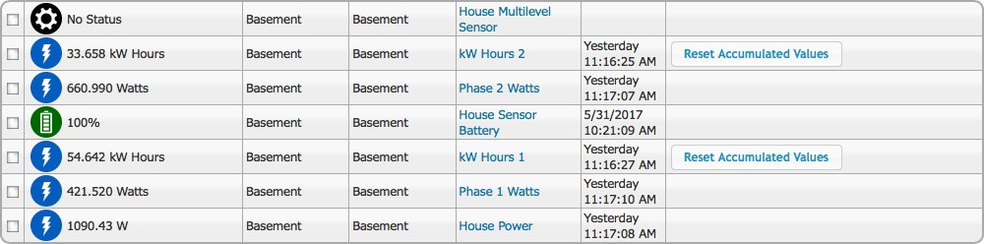
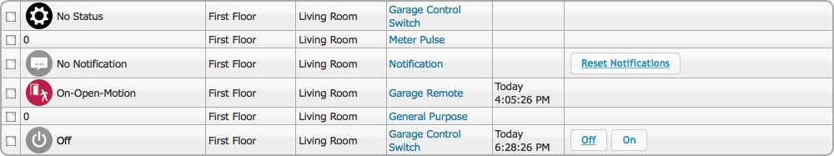
Electricity Meter Function:
Garage Control

Slide 13
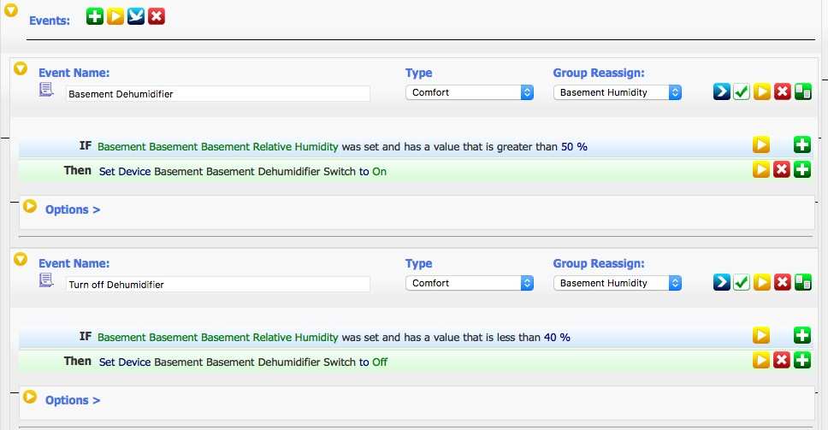

Slide 14


0
Event Name:
Doo, Lock Cod e
Type
us er c-ode
Group Reassign:
Home Security =8
£J --
IF The time is at 7:00 :00 AM
THEN El , Z-Wave Act con s El
Network: , C6B 8F3"1F (Nel wo rk C6BBF34Fl El
, Sel Security User Code
El
Oloose A D evice:
THEN El Z- Wave Act ion s
Network: , C6B8F34F (Nei work C6BBF34Fl El
S el a Security User Code
Oloose A D elli ce:
lll en Set user code 1 on device First loor Living Room Fr ont Door Lock to the 8 digit code provided. lll en Set user code 2 on device First Filoor Living Room Front Door Lock to the 8 d igit code provided. lll en Set user code 3 on device First Fil oor Living Room, Fr ont Door Lock to the 8 d igit code pr ovided. lll en Set user code 4 on device First loor Living Room, Fr ont Door Lock to the 8 digit code provided.
Event Name:
Natu re Ga,s
Type
D_a_n_g_,e_ro_u_s EI
Group Reassign:
, Home Security
El
£J --
I F First Floor Kltchen Room Natl.Ire Gas Sensor StatL1s changes and becomes o n-Open-Motion
111en Set Device First Floor Kitchen Room Kltchen Gas Valve to Off
EVentName:
Water Leak
Type
Dangerous
Group Reassign:
Home Security
£J --
IF Basement Basemen t Basement Water Sensor Binary changes and becomes On-Open-Motion
£J
£J
£J
OR IF Second Floor Second Bath room Bathroom Sensor Binary chang es and becomes On-Open-Mot ion
Tllen Set Device Basement Basement Main Water Valve to Off

Slide 15
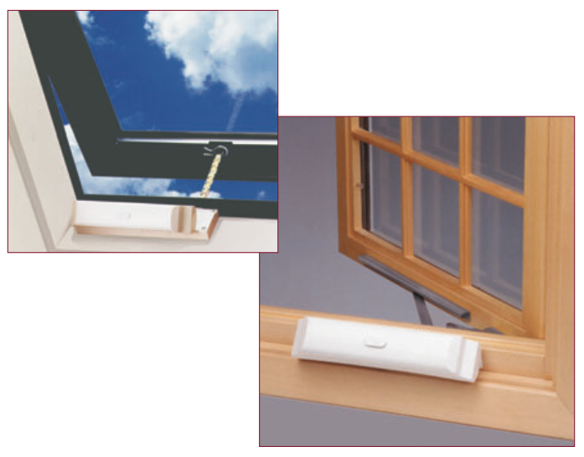
Automated Windows

Slide 16
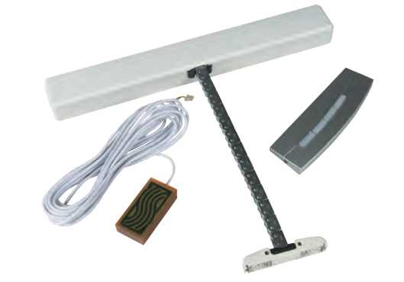
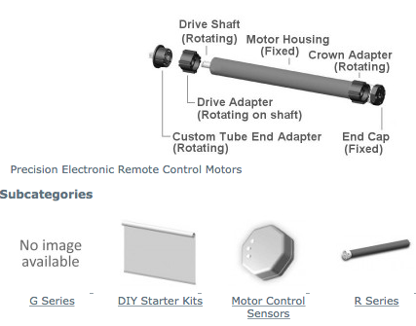

Slide 17
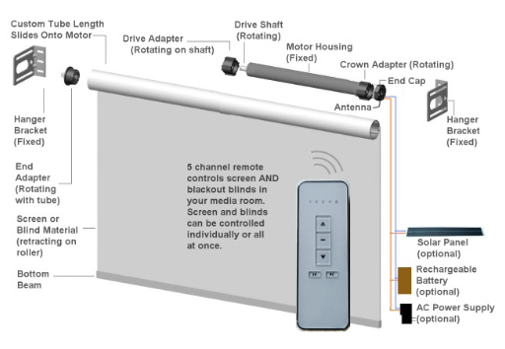

Slide 18
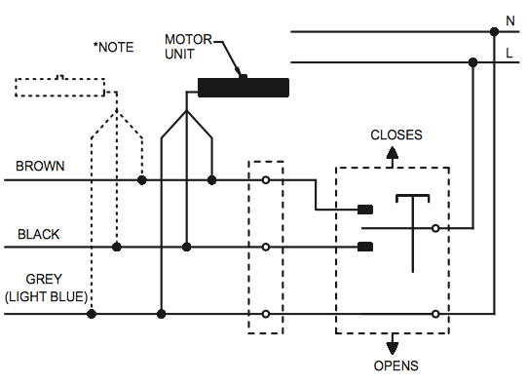

Slide 19
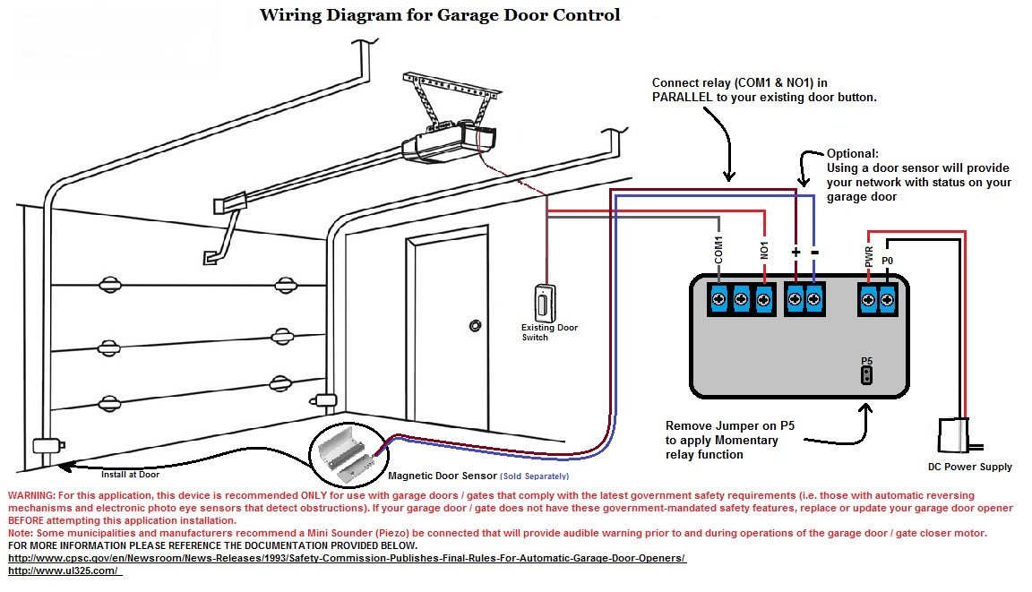
Garage Door Control

Slide 20
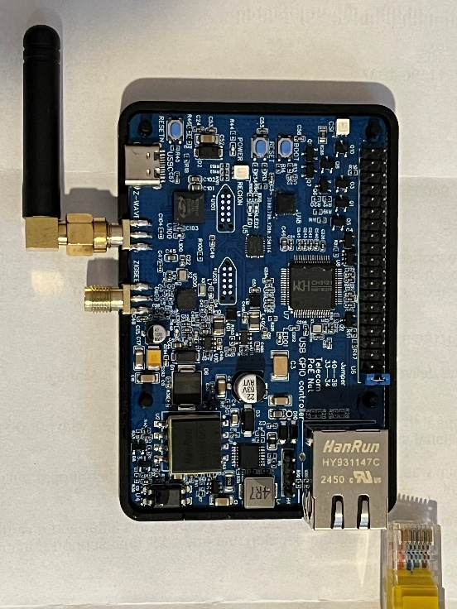
Products Released in 2024
Z-Wave 800 Controller and Z-Wave LR

Slide 21
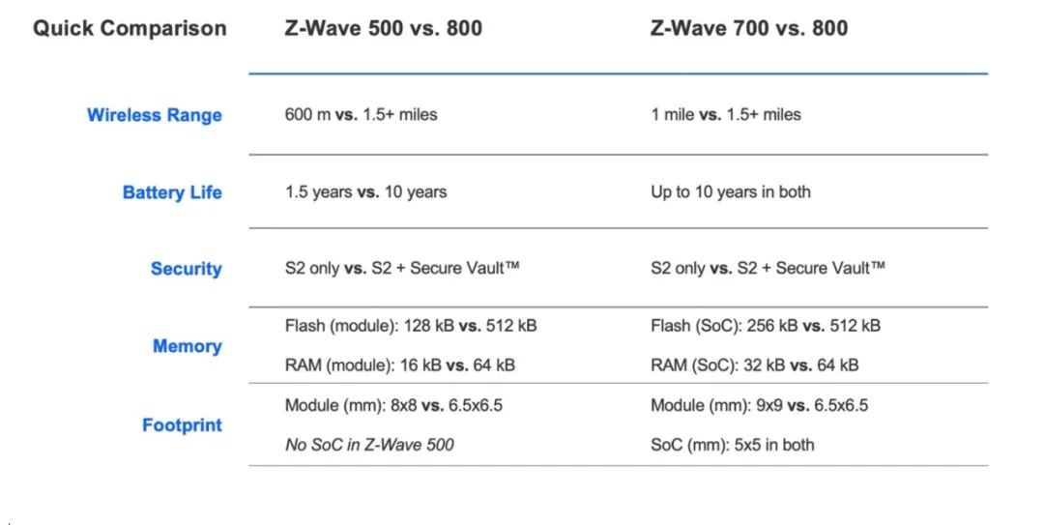
Introduction to the Z-Wave 800
Z-Wave is one of the world's most popular wireless protocols for smart homes, and the latest version, the Z-Wave 800 platform solution, was released in 2021. To date, the global market has over 3,600 products designed based on various versions of the Z-Wave platform. Taking devices based on the Z-Wave 500 and Z-Wave 700 series as examples, each has an installed base exceeding 100 million units.
Z-Wave Protocol Overview Z-Wave is an open wireless network connectivity protocol used for control, monitoring, and status reading applications in smart homes, building automation, and multi-dwelling units (MDUs). Z-Wave is a mature, proven, and widely deployed wireless protocol that provides affordable, reliable, and easy-to-use smart connectivity products to millions of people worldwide. The Z-Wave solutions we provide are end-to-end complete solutions, including software, hardware, and security for controllers and end devices.
Regarding updates to the Z-Wave platform versions, the Z-Wave 500 series modules released in 2013 provided devices compatible with Z-Wave Plus. Compared to the previous-generation 400 series, they featured greater wireless range, higher data rates, larger memory capacity, and lower power consumption. The Z-Wave 700 series was released in 2019, and compared to the 500 series, the 700 series SoCs and modules have significant improvements, such as faster wireless speeds, longer battery life, and wireless ranges of up to 1 mile.
The latest Z-Wave 800 series, launched in 2021, is the most advanced version of Z-Wave to date. The Z-Wave 800 SoCs and modules achieve major performance leaps with extremely low power consumption, button battery life exceeding 10 years, wireless ranges over 1.5 miles, and robust security.

Slide 22
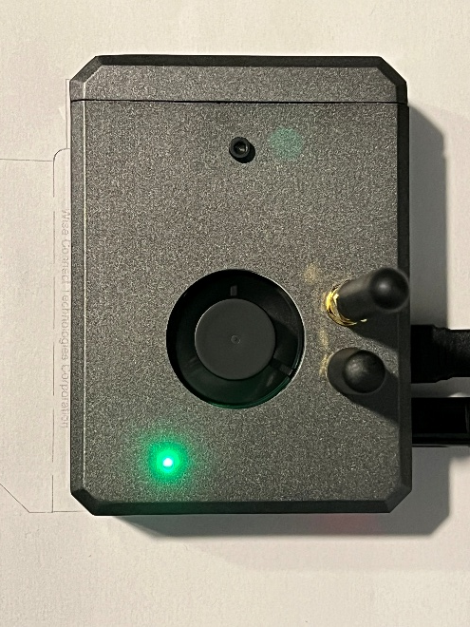
Extended Wireless Range One of the most fundamental improvements in the Z-Wave 800 series is the expansion of wireless range. With the 800 series, device manufacturers can achieve product ranges of up to 1.5 miles (over 2,300 meters), compared to over 1 mile (1,500 meters) in the 700 series. In residential, MDU, and building automation applications, the extended range enables products to connect with fewer network nodes, operate farther from the gateway, and extend beyond the yard. The ZG23 SoC features a unique +20 dBm transmission (TX) power, combining high output power with low power consumption.
Longer Battery Life Energy efficiency is critical for battery-powered IoT devices. The less power a product consumes, the more money end users save, while also reducing the hassle and waste associated with battery replacement. Both the Z-Wave 700 and 800 series offer button-cell battery life of up to 10 years. The ZG23 wireless SoC, based on the Z-Wave 800 platform, provides significant energy advantages over the Z-Wave 700 series, including a 30% reduction in transmission (TX) current and a 100% improvement in reception (RX) current efficiency.
Enhanced Security Both the Z-Wave 800 and 700 series include the standard S2 security framework. However, the 800 series, along with the ZG23 and ZGM230S hardware, also supports a wide range of Secure Vault™ features, such as Secure Boot, secure key management, anti-tampering, differential power analysis (DPA) countermeasures, and secure debugging.
Compared to the Z-Wave 500 series, the Z-Wave 800 module (ZGM230S) offers several advantages for device manufacturers and developers. Key points include: • The Z-Wave 800 series has a range of 1.5+ miles (2,300 meters), while the Z-Wave 500 series has a range of 600 meters. • The Z-Wave 800 series improves TX current by 5 mA and RX sensitivity by 5 dBm, enabling a button-cell battery life of up to 10 years (compared to 1.5 years in the Z-Wave 500). • The Z-Wave 800 module has a footprint of 6.5 x 6.5 mm, while the Z-Wave 500 module requires 8 x 8 mm—making the Z-Wave 800 module 25% smaller in size.

Slide 23
Future Trends
Redefine the protocol to complete a virtualized central control system. It will only require a lightweight control system—such as a Raspberry Pi—to control an entire city. The protocol will include storage for settings, control, and triggering—covering multiple sensors and multiple events triggering each device. Once the protocol matures, it will be implemented as a chip. The controller board will support frequencies for various countries, managed by software, and will include an external antenna.

