Slide 1

Precise Thermometer
The WISE CONN (thewiseconn.com)

Slide 2
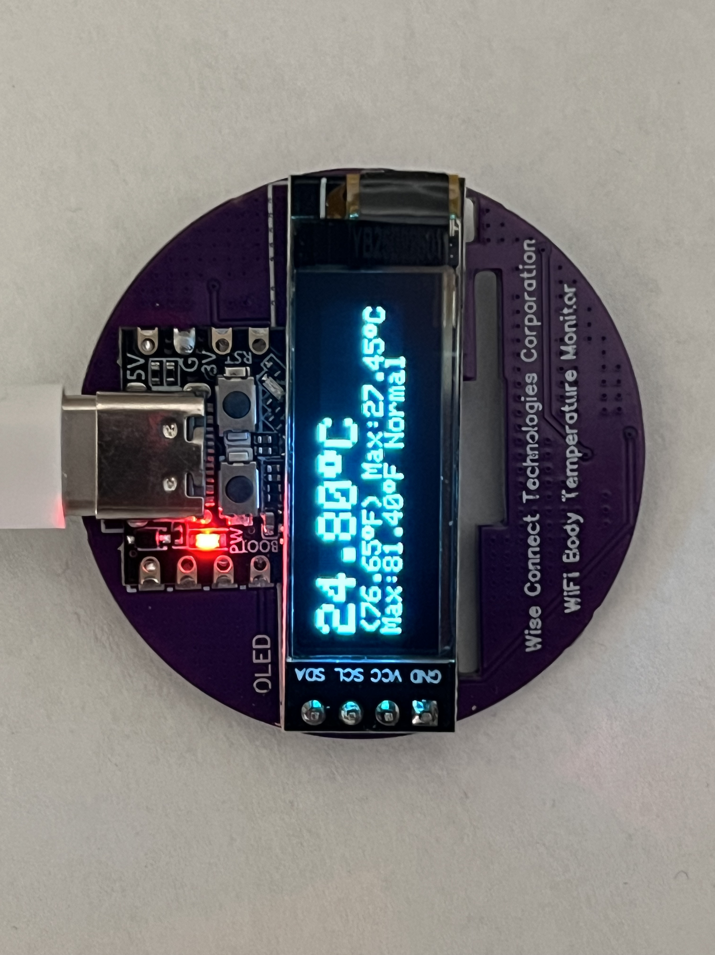
OVERVIEW
The Wise Connect Thermometer is a highly accurate wristwatch-style body thermometer that supports real-time wireless monitoring, enabling remote oversight and control by doctors, patients, or medical computer systems. The fever alert threshold can be configured by the doctor, patient, or network.
Accuracy
0.08℃ from 0℃ to 45℃,
0.09℃ from -25℃ to 85℃
0.12℃ from -40℃ to 85℃
0.15℃ from -55℃ to 125℃
0.3℃ from -55℃ to 155℃.

Slide 3
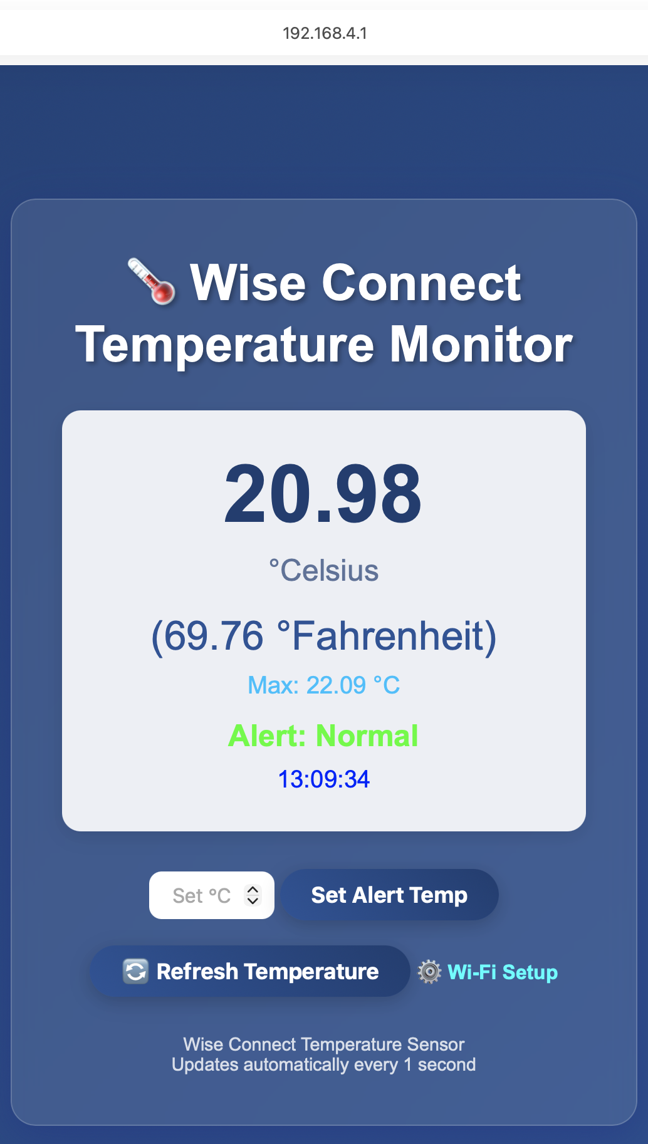
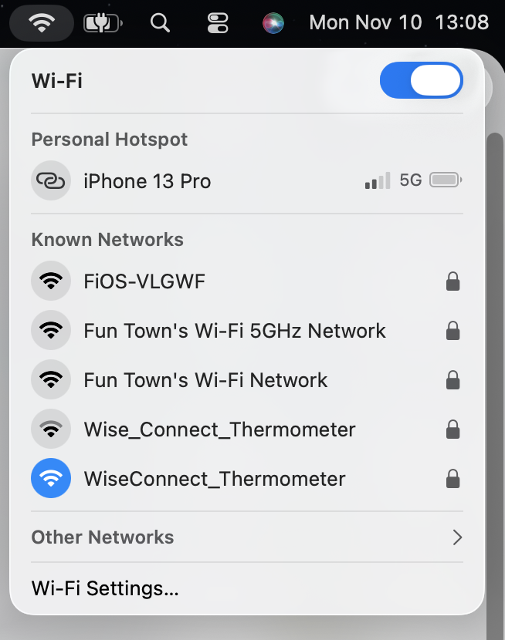
Configuration (192.168.4.1)

Slide 4
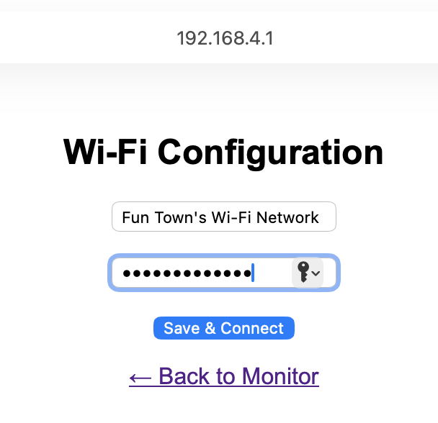

WIFI SETUP

Slide 5
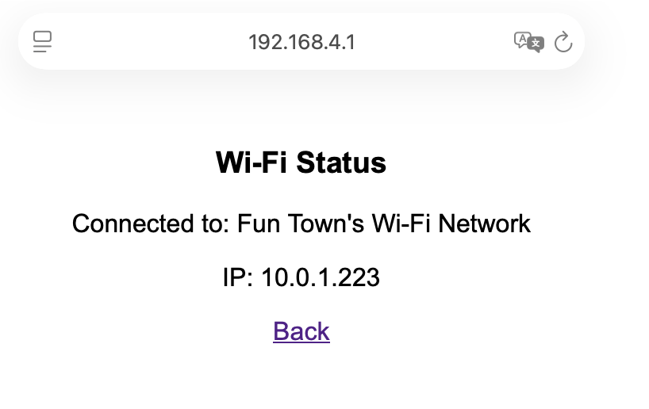
Wi-Fi Status

Slide 6
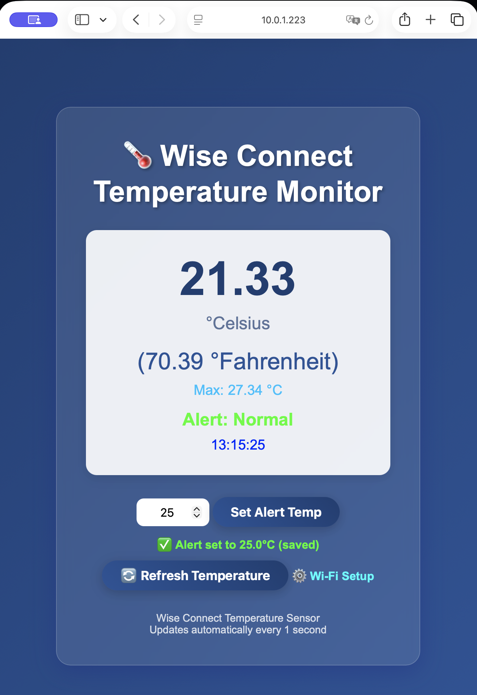
Temperature DISPLAYED On THE browser

Slide 7
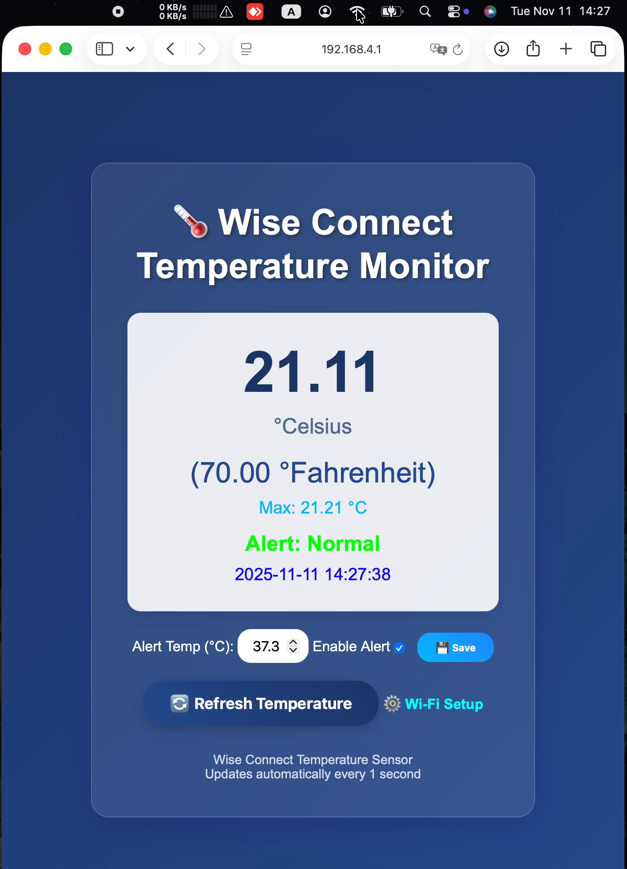
Refresh manually when necessary (video)

